Slide 1
Lightning presentation:
dean wan
GA Data Science Course - 2018 Part time

Slide 2

Beating the drop
Project:

Slide 3
Beating the drop:
Context
The Dream: English Premier League Armchair Manager
The Nightmare: Relegation - aka “the drop”
The Reality: You are poor and your players are awful

Slide 4
Beating the drop:
Key requirements
The Problem:
Build a first XI EPL squad that will achieve 40 league points across a 38 game season, on the lowest possible budget.
I will examine the key player attributes and ratings that correlate with league points across forwards, midfielders and defenders and create a team that achieves 40 points using the minimum possible transfer fees.

Slide 5
Beating the drop:
Key requirements
The Data:
Player ratings and attributes from video games (FIFA 18).
~5.7k individual players, with 77 different ratings and 91 attributes each (after cleaning & dropping).
League data from the official English Premier League website.

Slide 6
Beating the drop:
Key requirements
The Hypothesis:
40 league points (historical safety point) can be achieved by spending a maximum of €12m in transfer fees.

Slide 7
Beating the drop:
Key Assumptions and data
11 Players are required, with a combination of defenders, midfielders and forwards.
A minimum of 3 defenders and 2 midfielders are required in the first XI.
All players’ ratings are static and do not change.
Players are assumed to be available for 38 games (i.e. the effect of rest, injuries and international tournaments on players will be excluded).
All players in the squad are existing players in the EPL.
Current market value in € to be used as player value (i.e. transfer fee).

Slide 8
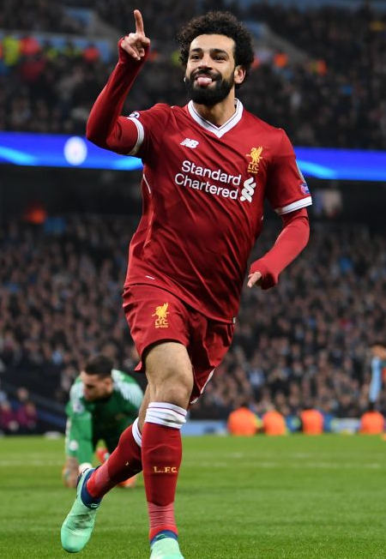
questions?
Beating the drop:

